Slide 1
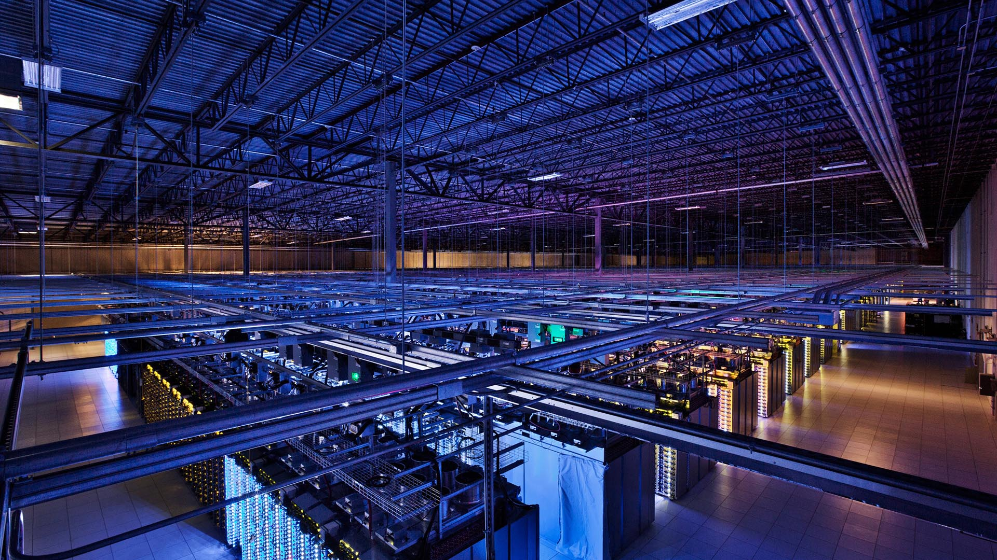
Corporate Social Responsibility

Slide 2
Our CSR Statement
At MCTS s.r.o., we are committed to supporting sustainable development and upholding ethical and social values. Our corporate social responsibility is not just an obligation but the foundation of our business and how we contribute to the prosperity and well-being of our employees, customers, and the communities where we operate.

Slide 3
Core Values
Innovation and Quality: We strive for constant innovation and deliver high-quality products and services that meet our customers' needs.
Respect and Trust: We respect the needs, values, and diversity of our employees, customers, and communities, fostering trust and mutual respect.
Sustainability and Environmental Protection: We work to minimize our ecological footprint and protect the environment through eco-friendly practices and innovative solutions.

Slide 4
CSR Initiatives
Education and Development: We invest in employee training and development programs, as well as support educational projects in the communities where we operate.
Environmental Sustainability: We have reduced energy consumption and waste in all our office and are committed to further reducing our environmental impact.
Community Engagement: We actively participate in local charitable and volunteer activities and support projects and organizations that contribute to the development of our communities.

Slide 5
Measurement and Reporting
We regularly assess and monitor the performance of our CSR initiatives and transparently report on our successes and progress.
We welcome feedback from our employees, customers, and communities and actively seek to improve our practices and programs.

Slide 6
Conclusion
At MCTS s.r.o., we are firmly committed to the values of corporate social responsibility and sustainable development. We are proud to contribute to positive changes in our communities and the environment, and we will continue our efforts to achieve these goals.

